Slide 1
SSR in React
How to build a SSR app in react without a meta framework like Nextjs, Remix

Slide 2
What does rendering mean?
Rendering -> Generation of HTML
SSR -> Server Side Rendering -> HTML is generated on the server
Other types of rendering is CSR -> Client Side Rendering -> HTML is generated via javascript in the Browser. Example, SPA apps , All the routing is handled on the client

Slide 3
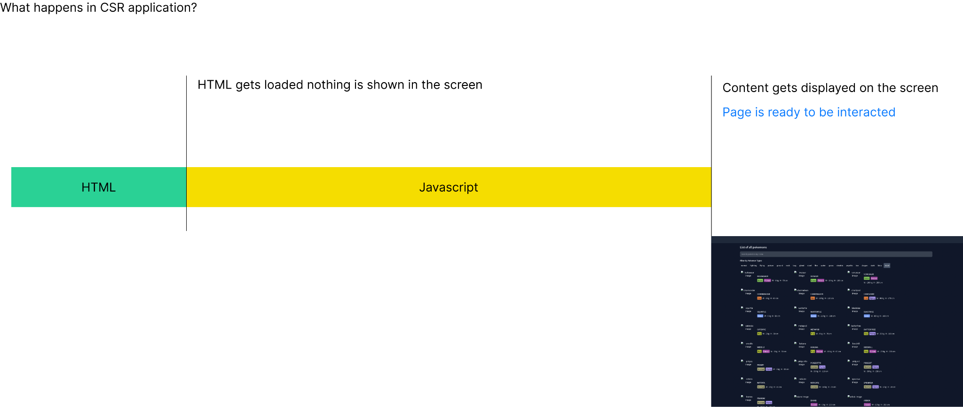

Slide 4
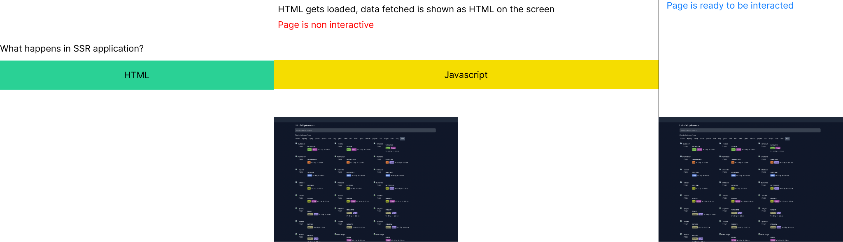

Slide 5
References
Suspense streaming architecture discussion - https://github.com/reactwg/react-18/discussions/37
React Docs - https://react.dev/reference/react-dom/server

